Slide 1
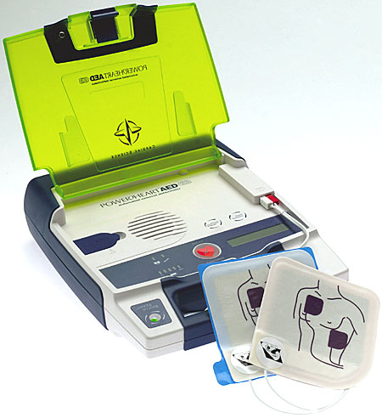
Using an AED

Slide 2
AED
The Students will be able to:
Learn how defibrillation works.
Identify the general steps in using an AED.
Learn Precautions when using an AED.
Practice using an AED in conjunction with CPR.

Slide 3
AED
Terminology
AED
– Automated External Defibrillator
A device that looks for abnormal electrical activity within the heart and elicits a shock to re-establish a normal effective heart rhythm.

Slide 4
AED Automatic External Defibrillator
AEDs can be found in most government buildings, most parks and recreation facilities, transportation hubs, casinos and theme parks.
Many retail stores have them too.

Slide 5
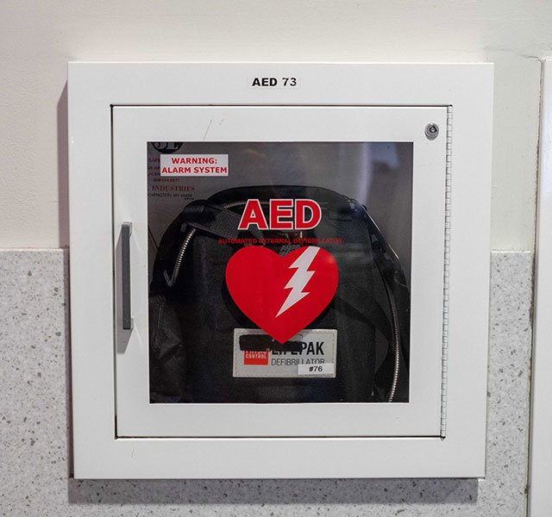
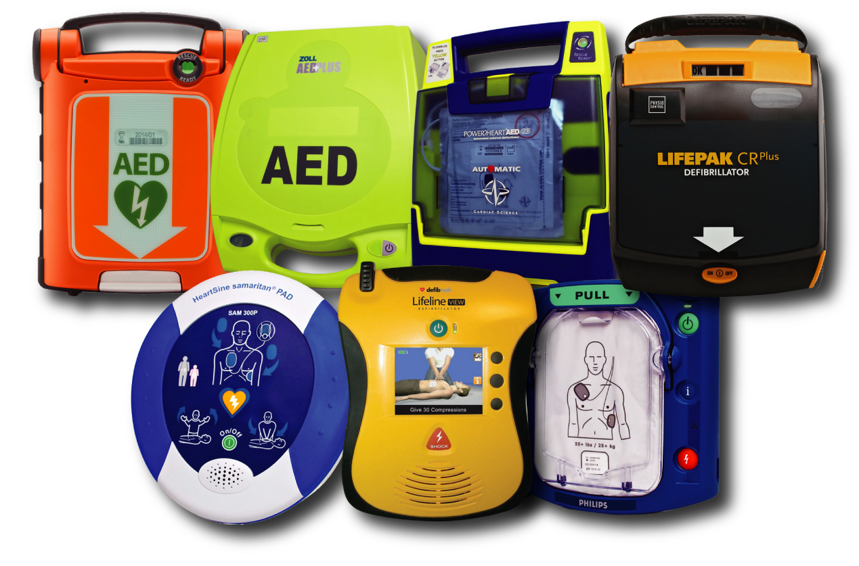

Slide 6
AED Automatic External Defibrillator
Terminology
Normal Heart Rhythm
The heart is controlled by its own electrical impulse. If the electrical impulse is functioning properly, the heart will beat normally.

Slide 7
AED Automatic External Defibrillator
Terminology
V-Tach
Ventricular tachycardia is where the heart is producing a very fast electrical contraction that does not allow the chambers of the heart to fill with blood. Blood will not circulate and the victim will be in cardiac arrest

Slide 8
AED Automatic External Defibrillator
Terminology
V-Fib
Ventricular fibrillation is where the heart is producing totally disorganized electrical activity. The heart chambers will not fill and blood will not circulate.

Slide 9
AED Automatic External Defibrillator
Terminology
Asystole
There is no electrical activity in the heart. The heart is dead

Slide 10
AED Automatic External Defibrillator
If doing CPR
Send someone to get the AED
Have them open AED
and TURN IT ON

Slide 11
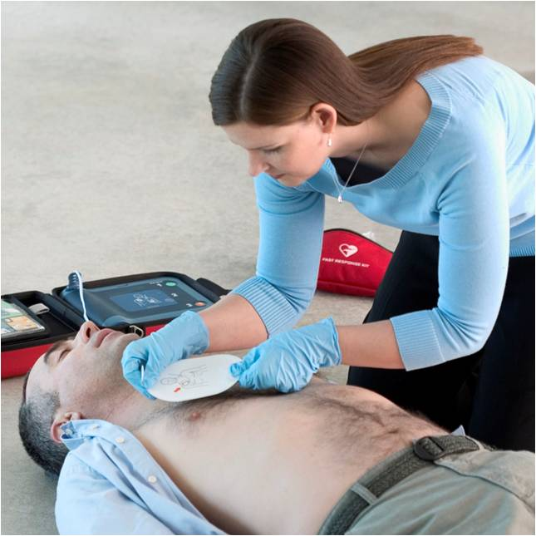
AED Automatic External Defibrillator
Listen to AED
Remove Pads and apply
to bare chest
Look at pictures on pads
Place 1 pad on upper RIGHT chest
Place other pad on lower LEFT chest
PLUG IN PADS to AED

Slide 12
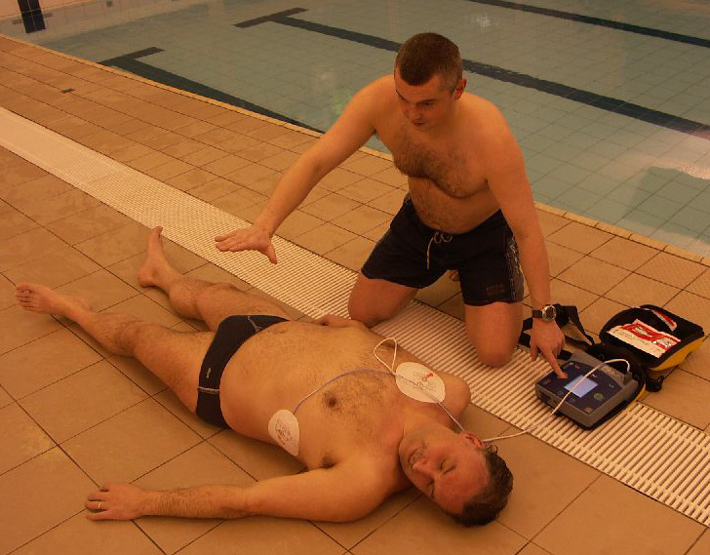
AED Automatic External Defibrillator
Listen to AED
Stay clear of Victim
Do not touch
Let AED analyze
rhythm of heart
AED will say Shock Advised if needed

Slide 13
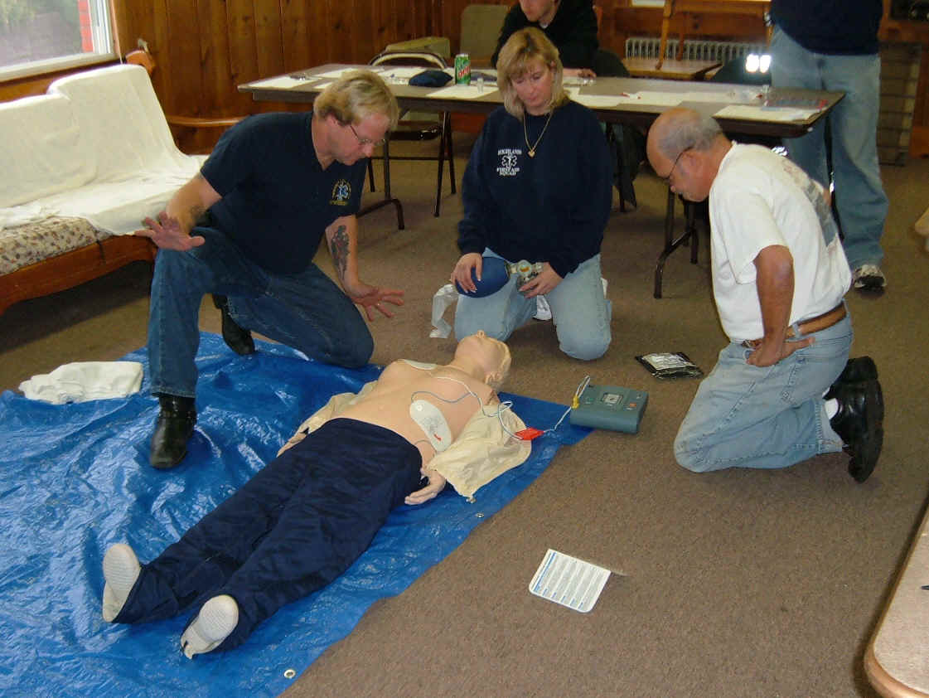
AED Automatic External Defibrillator
Listen to AED
Prepare to Shock
STAY CLEAR
Make sure that no one
is touching the victim
Shock when advised
Push button

Slide 14
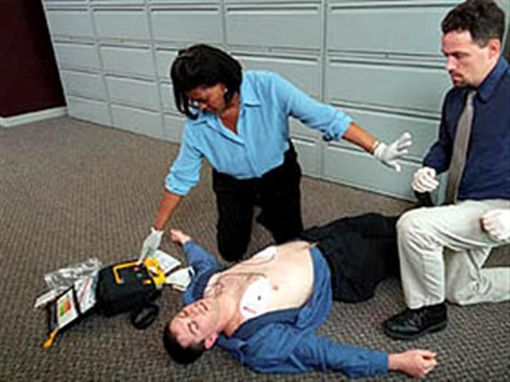
AED Automatic External Defibrillator
Listen to AED
After shock, AED will
Re-analyze heart rhythm
Everyone MUST stay clear
Listen to AED

Slide 15
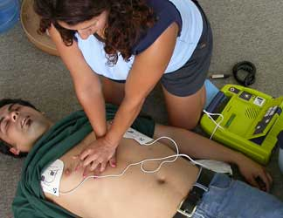
AED Automatic External Defibrillator
If NO SHOCK ADVISED
Check for signs of life
ABC’s
Do CPR for 1 minute if needed
After one minute of CPR
Let AED analyze heart rhythm

Slide 16
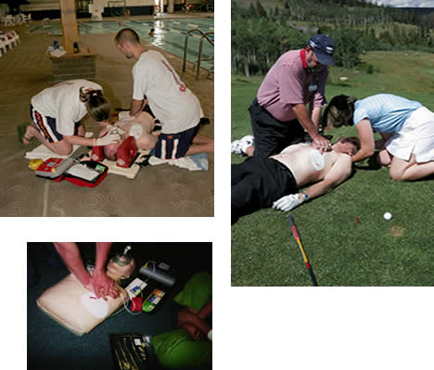
AED Automatic External Defibrillator
If NO SHOCK ADVISED
Care for the conditions
you find
ABC’s

Slide 17
AED Automatic External Defibrillator
*For every minute a rescuer delays using an AED on a victim suffering cardiac arrest
The victims chance of survival drops by 10%

Slide 18
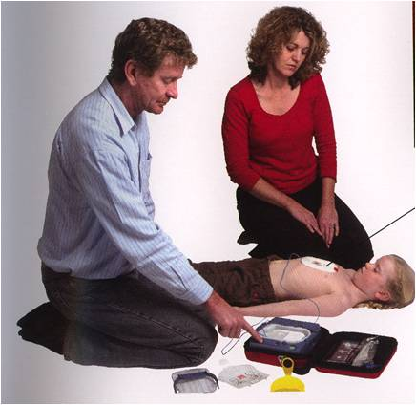
AED Automatic External Defibrillator
Rescuer needs to apply pads to victims:
BARE, DRY Chest
This means cutting or removing clothing and drying chest

Slide 19
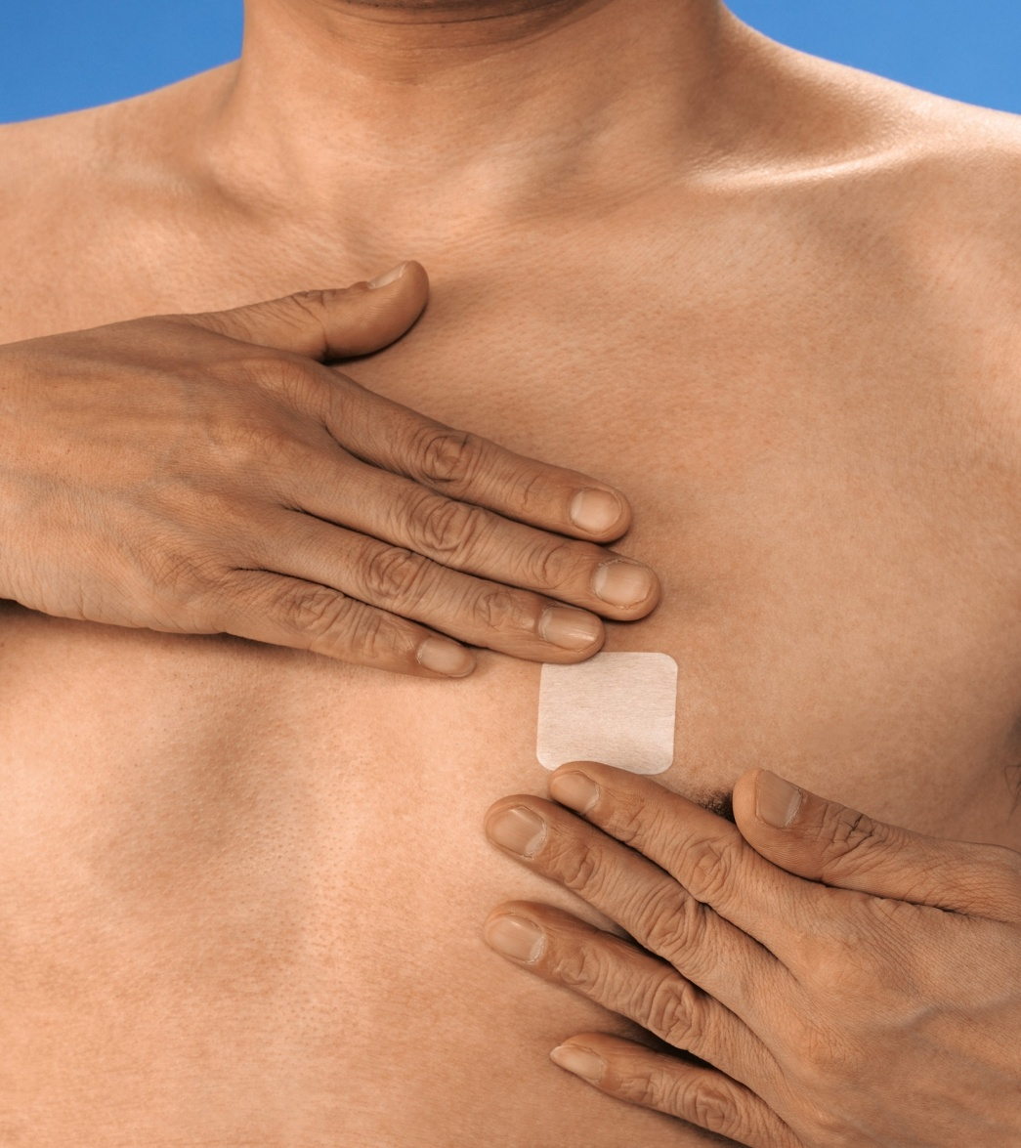
AED Automatic External Defibrillator
If rescuer sees any type of Medicinal Patch on victim, It MUST be removed

Slide 20
AED Automatic External Defibrillator
Victim must be placed on:
Back
Dry surface
Non-metallic surface
Do NOT use any portable radio devices or cellular phones within 6 feet of victim

Slide 21
AED Automatic External Defibrillator
What about Metal?
What about electrical conductors?
Pacemakers?

Slide 22
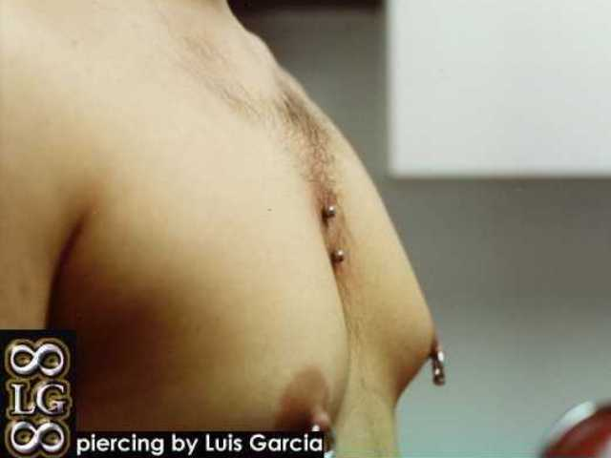
AED Automatic External Defibrillator

Slide 23
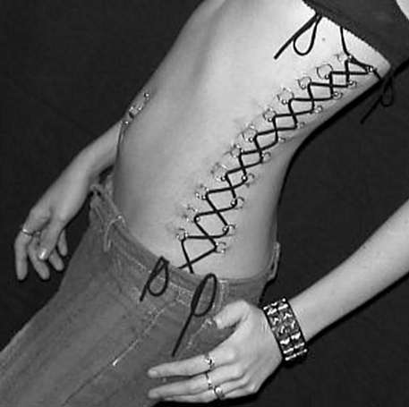
AED Automatic External Defibrillator
Think about where the pads go.

